Slide 1
Project Management

Slide 2
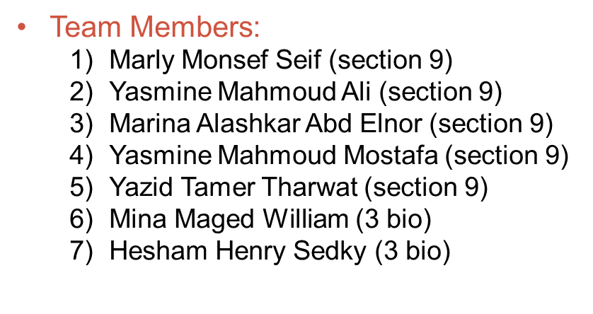

Slide 3
Project Name: Electronic Correction.
Project Sponsor: The Ministry of Higher Education.
Project Manager: Eng / Alaa Abdulfattah
Project Description: to introduce a new system to correct exams faster.
Business Case:
The problem:
One of the most important gains that the Ministry of Higher Education will achieve with the electronic correction is that it will certainly improve relations between university professors, correctors and students.
Many students believe that correction in universities has a degree of bias and prejudice By relying on the electronic correction, the ministry can restore confidence to them.
The test taker can print papers using any printer and on any type of low-cost paper. Exam results can also be obtained in less than an hour. The time saving factor here is the most important advantage of the electronic correction.
The solution:
A group of programmers enables the exam maker to design exam forms and scan them to enter the program for debugging. It also has the ability to design multiple forms for a single test and include

Slide 4
a barcode for the forms. Instead of the old and usual examination system that requires a great deal of time in printing and correcting them. It is also possible to do electronic exams, which facilitates the movement of correction and saves a lot of time.
Project Scope:
The system will be applied to all computer and information faculties in all the Republic.
Modern machines are used to correct a specific type of paper by connecting them to computers.
The application that allows students to be tested online.
Use a dedicated printer to print paper called bubble sheet.
Project Deliverables:
Application enables the exam maker to design exam forms and scan them to enter the program for debugging, or we change the exam method to make it online. Preferably if all questions were mcq, it will make correction faster.
Project Resources:
Available devices.
A team of trainers.

Slide 5
Budget:
500.000 $ (includes servers, project licenses, developers, designers ,training).
Project milestons (Time line of project):
In the three weeks , the team of programming will collect information.
For five weeks , we will test the devices and installation.
For 2 months , we will design a desktop.
For 2 months , we will make a web application.
The project is being tested for 1 month.
Constraints:
The project must take time less than 7 months.
The project must not exceed 500.000 $ .
It must be on computers in college labs.
Exclusions:
Other colleges are not subject to this experience.

Slide 6
Risks:
1)That the number of team members is not enough to complete the project according to the requirements.
2)Machine Corruption
Machines need regular follow-up and maintenance.
3)Time Risk
we can not finish the project during the deadline.
4)Budget Risk
That the project will cost more than the specified budget.
5)Programmers
Programmers can not implement the program requirements as required.

Slide 7

Work Breakdown Structure:
Electronic Correction
Planning
Paper
Online
Collect Information
Installation
Web Application
Devices
Desktop
FrontEnd
BackEnd
coding
design
Test

Slide 8
Responsibility Matrix:
Task | Marly | Marina | Yasmine | Yasmine | Mina | Hesham | Yazid
Collection information | R |  | S |  | S
Devices |  |  |  | S |  | R | S
Installation | S |  | R |  |  | S
desktop |  | R |  | S |  |  | S
Coding – design | S |  |  | R | S
Web application |  | S | S |  |  |  | R
Frontend – backend |  |  |  |  | R | S
test | R |  |  |  |  | S | S
R = responsible
S = support

Slide 9
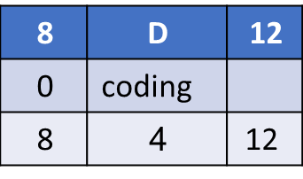
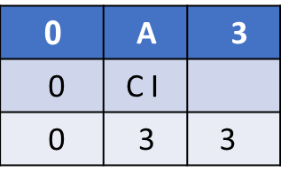
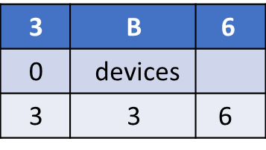
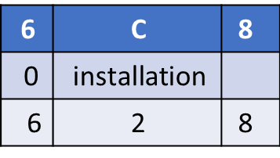





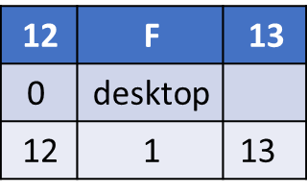

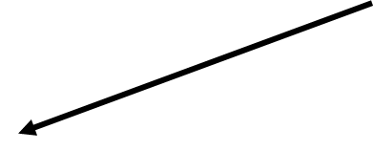

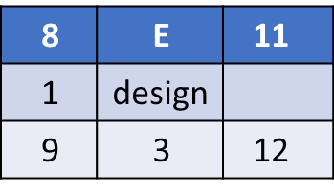


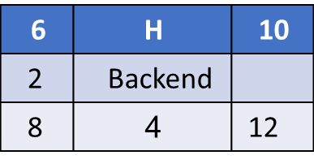
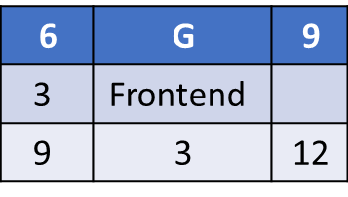
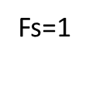
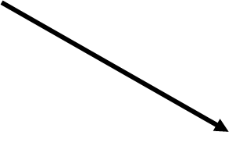

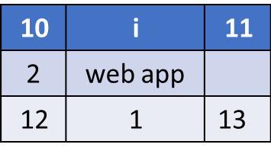
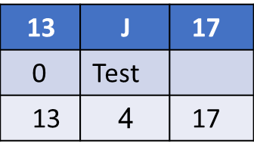
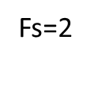
Project Network:
A B C D F J

Slide 10
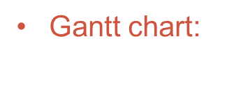

Slide 11
Resource-Constrained Schedule:

Slide 12
Final Resource-Constrained Schedule:

Slide 13
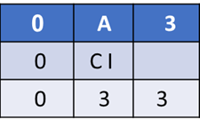

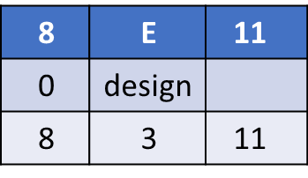
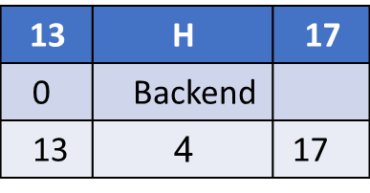
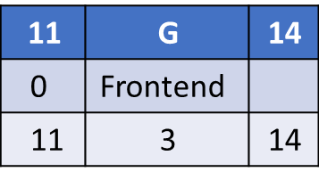
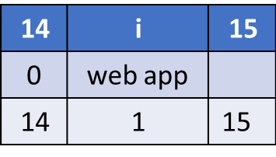
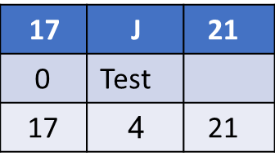
Final Project Network:

Slide 14
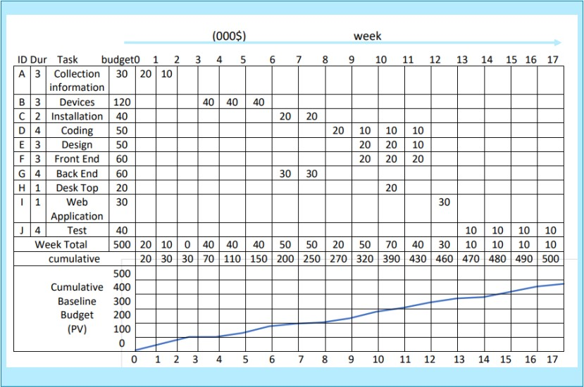
Time-phased work packages:

